Slide 1
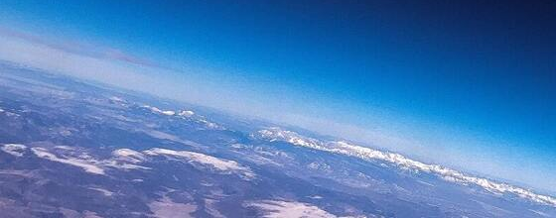
Spaceship Titanic
R Project

Slide 2
Spaceship Titanic - R Project
For this project, you will analyze a data set from Kaggle (see link). The Kaggle project is asking for us to do machine learning, but we're just going to use our brains to draw conclusions from the data set. This is a larger data set than previous examples, similar to the Social Media Stocks data, so keep that in mind. Additionally, it is very hard to quantify what a 'good' project looks like here, so I will primarily be grading based on whether or not you have given the assignment an honest attempt and produced analysis. I will be looking for evidence of 'digging in' to the data, and a presentation of the data. To that end, two files will be submitted: One, an R notebook with all your inspection; please do not delete queries of the data unless you have misspelled them. I want to see your work, even if you ended up going in a different direction than you originally planned. And then I would like to see a file that includes some presentation - some graphs, maybe a paragraph-long writeup of what you discovered in tandem with the graphs, or a short (3-5 minute) video of you presenting your findings. Be creative! We've seen what data analysis looks like for some time now; now it is your chance to turn and show your skills.
https://www.kaggle.com/competitions/spaceship-titanic/data?authuser=0

Slide 3
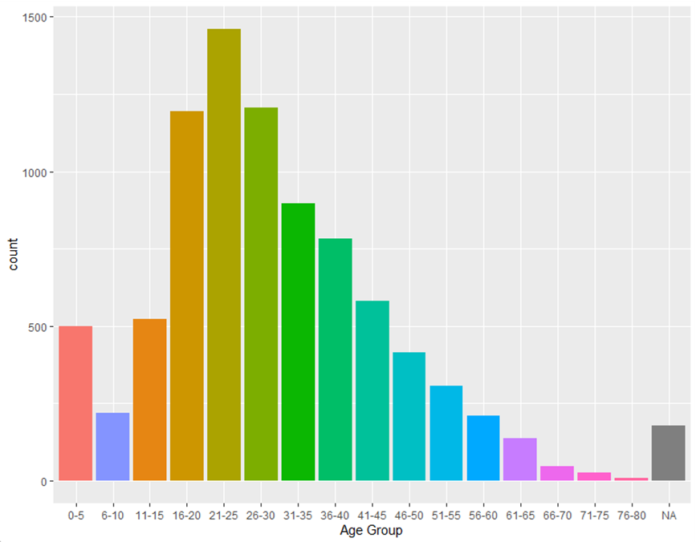
Spaceship Titanic - Initial Passenger Analysis
Initial Passenger Analysis
Total passengers: 8,693
Number of passenger groups: 6,217
Passenger age breakdown (see graph on the right)
VIP passengers: 199
Passengers transported to another dimension: 4,378
Passengers electing cryosleep: 3,037
Passengers billed for one or more amenities: 5,040
Conclusions
Majority of passengers are 16-45 years of age
Very few passengers were VIP
Approximately half were transported to another dimension
Slightly over one-third elected cryosleep
Majority not electing cryosleep paid for some amenities

Slide 4
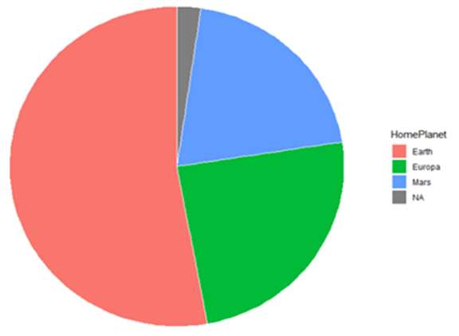
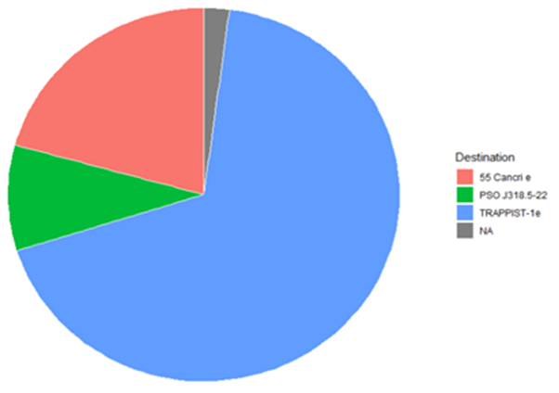
Spaceship Titanic – Home and Destination Analysis
Passenger Breakdown by Home Planet
Home Planet Count
Earth 4602
Europa 2131
Mars 1759
NA 201
Conclusion: Earth is the home planet for over 50% of the passengers, with Europa and Mars each making up approximately 25% each.
Passenger Breakdown by Destination
Destination Count
55 Cancri e 1800
PSO J318.5-22 796
TRAPPIST-1e 5915
NA 182
Conclusion: TRAPPIST-1e is the destination for approximately 70% of passengers, with 55 Cancri e at 20% and PSO J318.5-22 at 10%.

Slide 5
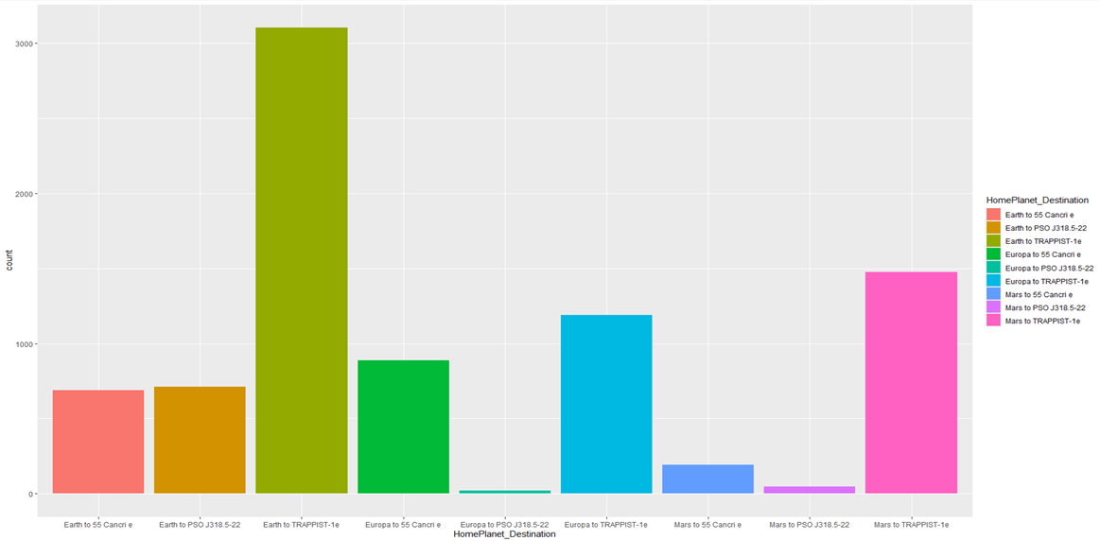
Spaceship Titanic – Home to Destination Analysis
Home to Destination View
Trip Count
Earth to TRAPPIST-1e 3101
Mars to TRAPPIST-1e 1475
Europa to TRAPPIST-1e 1189
Europa to 55 Cancri e 886
Earth to PSO J318.5-22 712
Earth to 55 Cancri e 690
Mars to 55 Cancri e 193
NA to TRAPPIST-1e 150
Earth to NA 99
Mars to PSO J318.5-22 49
Mars to NA 42
Europa to NA 37
NA to 55 Cancri e 31
Europa to PSO J318.5-22 19
NA to PSO J318.5-22 16
NA to NA 4
Total 8693
Conclusion
Overall, this data is in line and was predictable based on the home planet and destination data from the prior slide. The only slight surprise was the Europa to 55 Cancri e trip count being higher than the Earth to 55 Cancri e trip count.

Slide 6
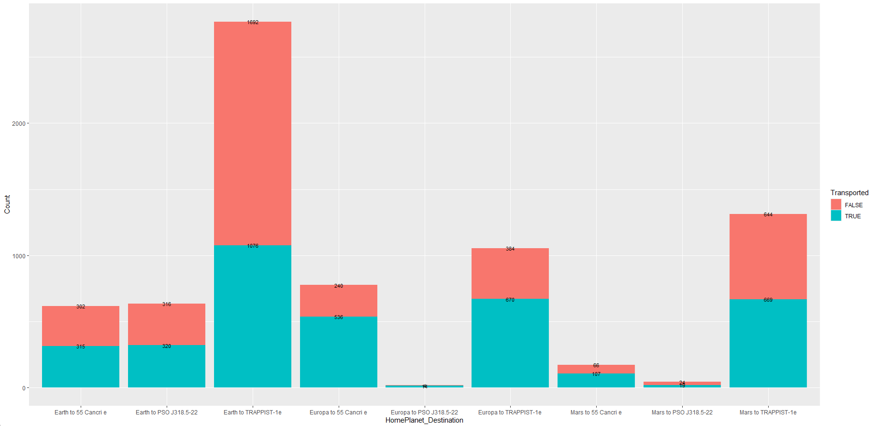
Spaceship Titanic – Transported Dimensions Analysis
Transported Dimensions
Trip Count
Earth to TRAPPIST-1e 1076
Europa to TRAPPIST-1e 670
Mars to TRAPPIST-1e 669 Europa to 55 Cancri e 536
Earth to 55 Cancri e 536
Earth to PSO J318.5-22 320
Mars to 55 Cancri e 107
Mars to PSO J318.5-22 19
Europa to PSO J318.5-22 14
Total 3947
Conclusion
For all trips, other than Earth to TRAPPIST-1e, over half of the passengers transported to another dimension. This is an interesting finding that requires additional research. Prior to analysis my expectation was the home planet and destination would determine the transportation to another dimension, however, that was incorrect.

Slide 7
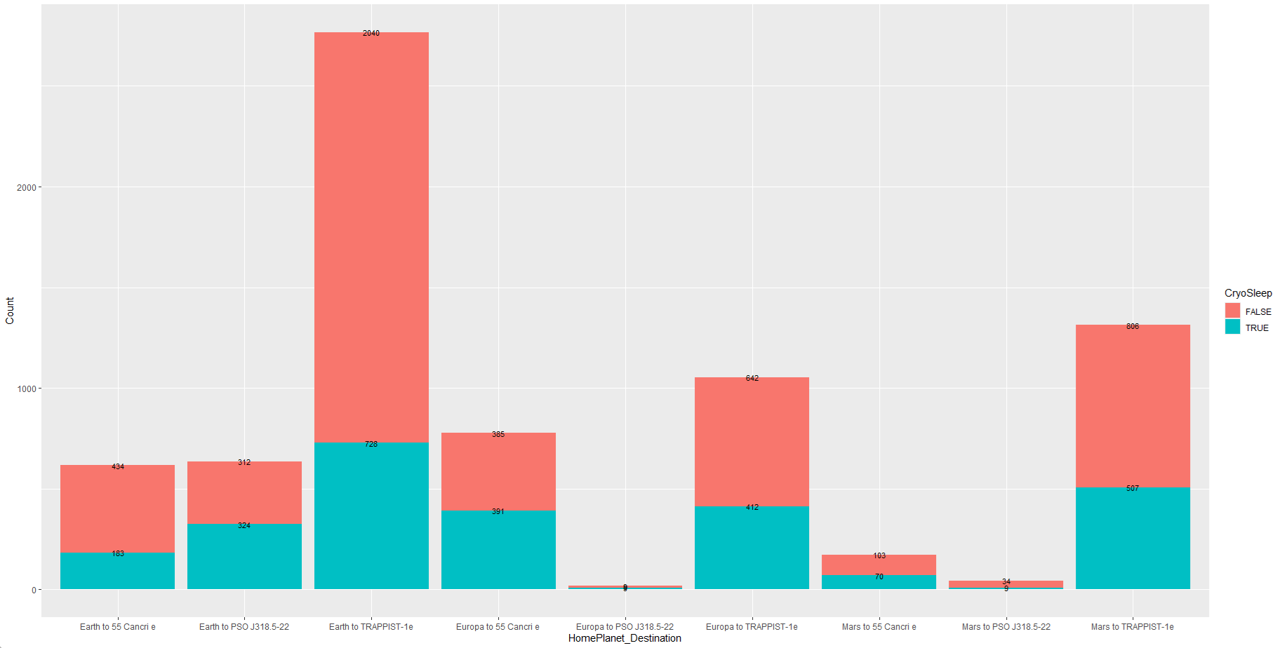
Spaceship Titanic – Passenger CryoSleep Analysis
Elected CryoSleep View
Trip Count
Earth to TRAPPIST-1e 728
Mars to TRAPPIST-1e 507
Europa to TRAPPIST-1e 412
Europa to 55 Cancri e 391
Earth to PSO J318.5-22 324
Earth to 55 Cancri e 183
Mars to 55 Cancri e 70
Mars to PSO J318.5-22 9
Europa to PSO J318.5-22 9
Total 2633
Conclusion
The highest percentages of cryosleep are for the Earth to PSO J318.5-22 and Europa to 55 Cancri e trips, with just over half of the passengers electing cryosleep. All other trips fall within a 30-40% range of passengers electing cryosleep.

Slide 8
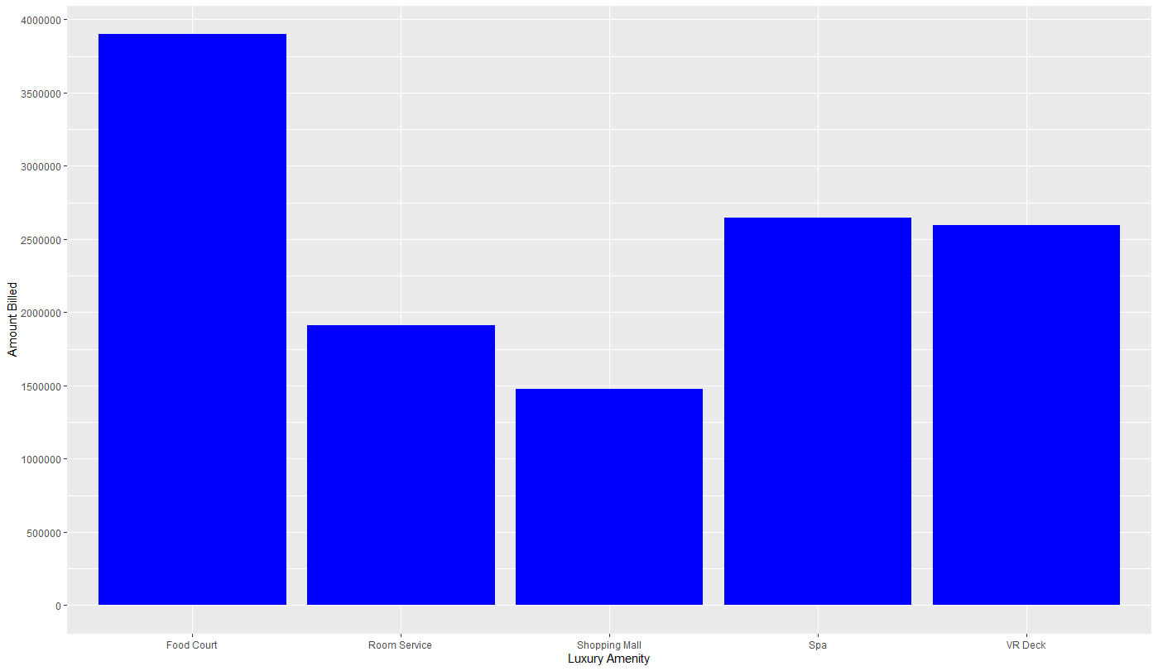
Spaceship Titanic – Amounts Billed on Amenities
Amounts Billed on Amenities
Amenity Amount
Food Court $3,898,237
Spa $2,647,791
VR Deck $2,592,790
Room Service $1,912,541
Shopping Mall $1,474,092
Total $12,525,451
Conclusion
The food court accounts for almost a third of the total amount billed on amenities. Adding the food court and room service, eating makes up approximately 50% of the total amount billed on amenities. The spa and VR deck each makeup approximately 20% of the total amount billed, with the shopping mall accounting for just over 10%.

